Slide 1


Slide 2

Today’s lecture Breakdown:
I/O
Interrupts
Interrupt processing
Interrupt processing with priority

Slide 3

Book reading : Supplementary !!!
Topics covered in this lecture are from these texts.
Comp. Org. & Architecture,9th edition,Stallings
For interrupts (Relevant to slides only)
Read Chapter Top level view of Computer Functions,Section 2 (subpart) Interrupts
For Input / Output (Relevant to slides only)
Read Chapter Input / Output ,section 1,2
Section 3,4 (Relevant details related to slides only)

Slide 4
Input/output : I/O

Slide 5
Input/output Problems
Why I/0’s not directly connected to system bus?
Wide variety of peripherals
Delivering different amounts of data
At different speeds
In different formats
All slower than CPU and RAM
Need I/O modules

Slide 6
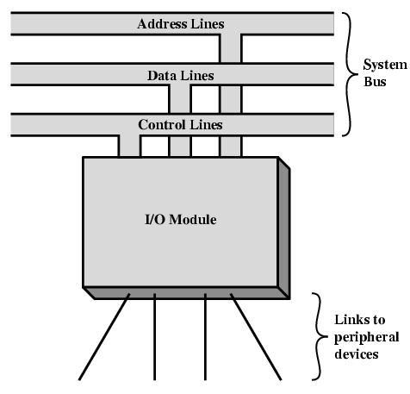
Input/Output Module
Interface to CPU and Memory
Interface to one or more peripherals

Slide 7
External Devices
An external device connected to an I/O module is called peripheral device or simply peripheral.
Human readable
Screen, printer, keyboard
Machine readable
Monitoring and control
Disks,sensors,actuators etc.
Communication
Modem
Network Interface Card (NIC)
Computers in a network.

Slide 8
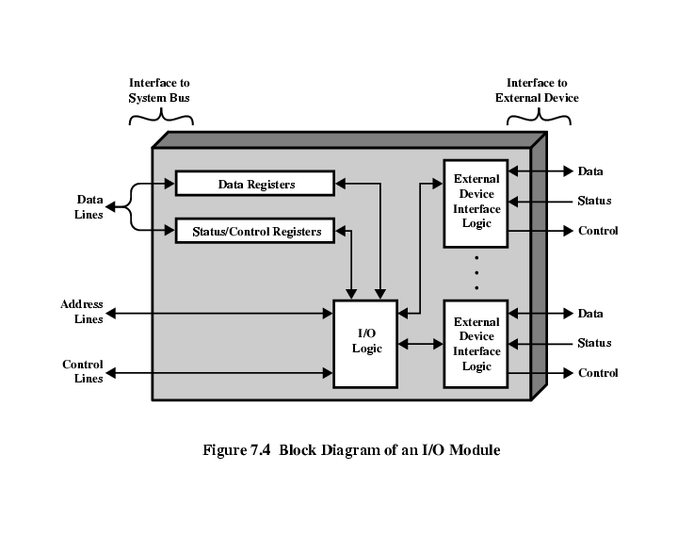
I/O Module Structure : Diagram

Slide 9
I/O Module Function
I/O Module functioning could be explained by processor communication.
Command decoding
Data
Status reporting
Address Recognition
Command decoding : I/O module accepts commands from processor on Control bus, Like read or write data.
Data : Data is exchanged between processor and I/O module over data bus

Slide 10
I/O Module Function
I/O Module functioning could be explained by processor communication.
Command decoding
Data
Status reporting
Address Recognition
Status Reporting : I/O module are much slower than CPU and memory, they had to send STATUS signals to report their progress.
For Example : BUSY or READY signal to report I/O status to processor

Slide 11
I/O Module Function
I/O Module functioning could be explained by processor communication.
Command decoding
Data
Status reporting
Address Recognition
Address Recognition : I/O module must receive multiple requests from processor thus I/O module must recognize and decode each address.
For Example : After decoding I/O will identify, send control and data signal to selected peripheral.

Slide 12
I/O Module Function
Control & Timing
CPU Communication
Device Communication
Data Buffering
Error Detection

Slide 13
I/O Steps
CPU checks I/O module device status
I/O module returns status
If ready, CPU requests data transfer
I/O module gets data from device
I/O module transfers data to CPU
Variations for output
Direct CPU Access
Direct Memory Access

Slide 14
CPU Viewpoint
Issue read command
Do other work
Check for interrupt at end of each instruction cycle
If interrupted:-
Save context (registers)
Process interrupt
Fetch data & store

Slide 15
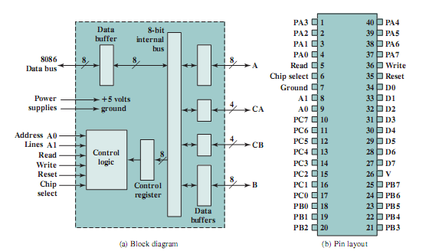
Interfacing I/O & processors :

Slide 16
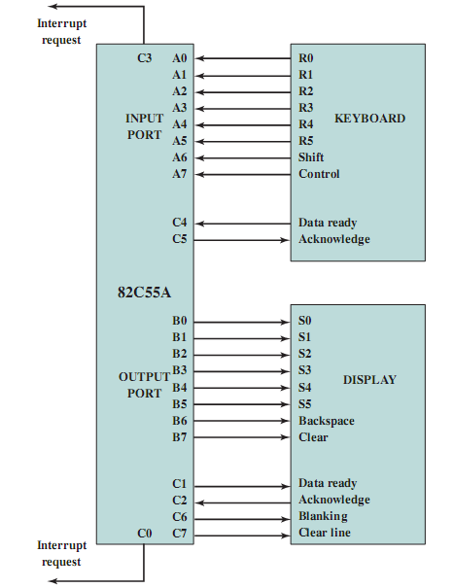
Keyboard/Display Interfaces to 82C55A

Slide 17
Interrupts

Slide 18
Interrupts
Mechanism by which other modules (e.g. I/O) may interrupt normal sequence of processing
Program
e.g. overflow, division by zero
Timer
Generated by internal processor timer
Used in pre-emptive multi-tasking (Preemptive scheduling enforces modularity in the sense that one thread cannot stop the progress of another thread, but if all threads share a single address space, then they can modify each other's memory accidentally)
I/O
from I/O controller
Hardware failure
e.g. memory parity error

Slide 19
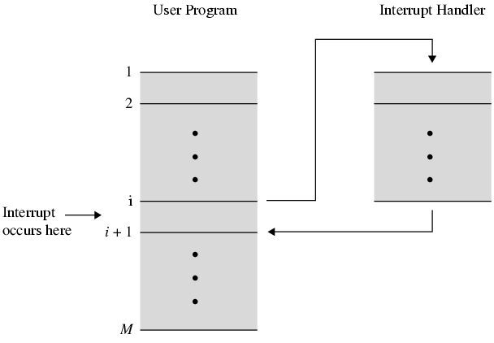
Transfer of Control via Interrupts

Slide 20
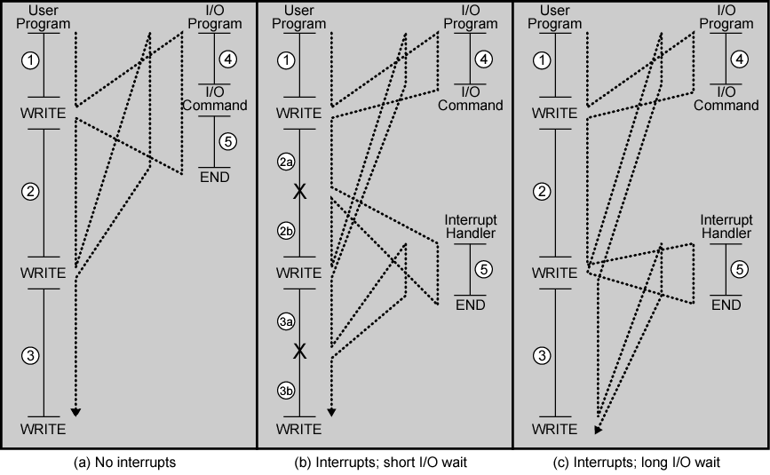
Program Flow Control

Slide 21
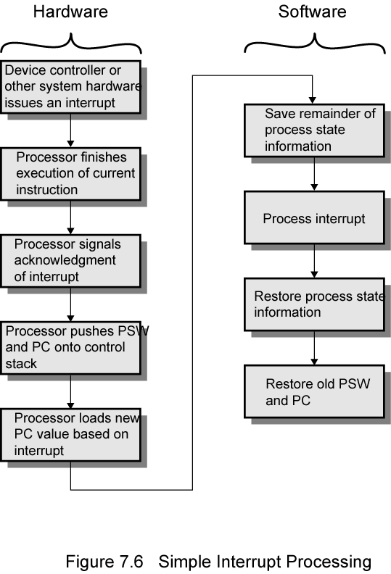
Simple Interrupt Processing

Slide 22
Interrupt Cycle
Added to instruction cycle
Processor checks for interrupt
Indicated by an interrupt signal
If no interrupt, fetch next instruction
If interrupt pending:
Suspend execution of current program
Save context
Set PC to start address of interrupt handler routine
Process interrupt
Restore context and continue interrupted program

Slide 23
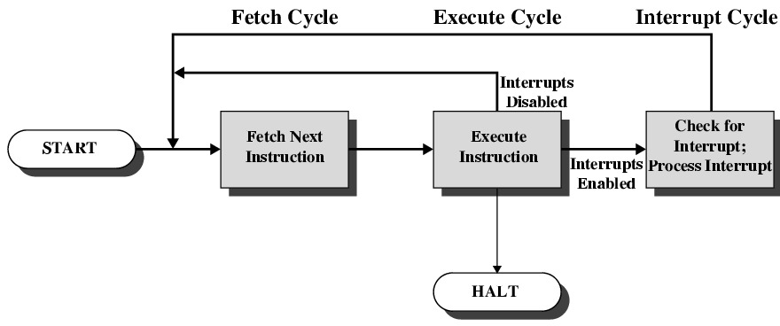
Instruction Cycle with Interrupts

Slide 24
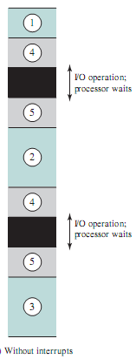
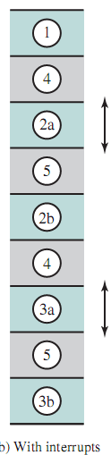
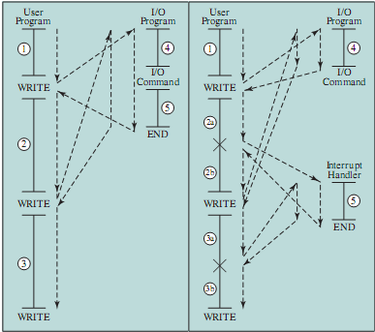
Program Execution Timing : Short I/O Wait

Slide 25
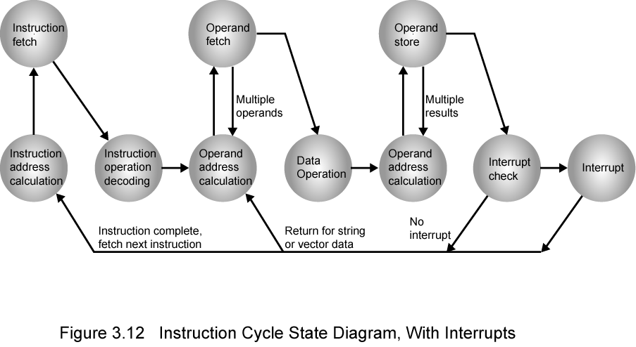
Instruction Cycle with Interrupts :

Slide 26
Multiple Interrupts
Disable interrupts
Processor will ignore further interrupts whilst processing one interrupt
Interrupts remain pending and are checked after first interrupt has been processed
Interrupts handled in sequence as they occur
Define priorities
Low priority interrupts can be interrupted by higher priority interrupts
When higher priority interrupt has been processed, processor returns to previous interrupt

Slide 27
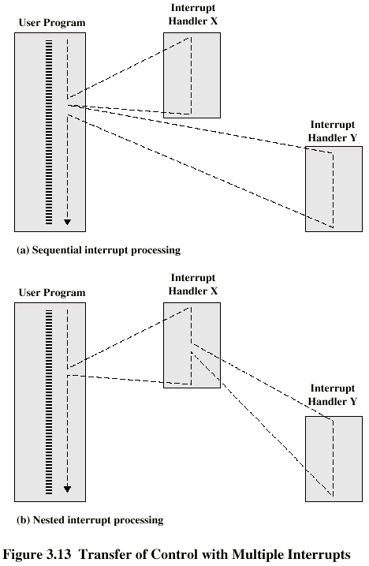
Multiple Interrupts – Sequential Processing

Slide 28
Multiple Interrupts – Nested

Slide 29
Priority Interrupt Execution : Example
Three I/O devices, a printer, a disk and data communication line with increasing priority of 2,4,and 5 respectively. Suppose all interrupt requires same execution time i.e 10ns. Following events occurs
Sr. # | Time (ns) | Activity/event
1 | t = 0 | User Program Starts
2 | t = 10 | Printer interrupt
3 | t = 15 | Communication interrupt
4 | t = 20 | Disk interrupt

Slide 30
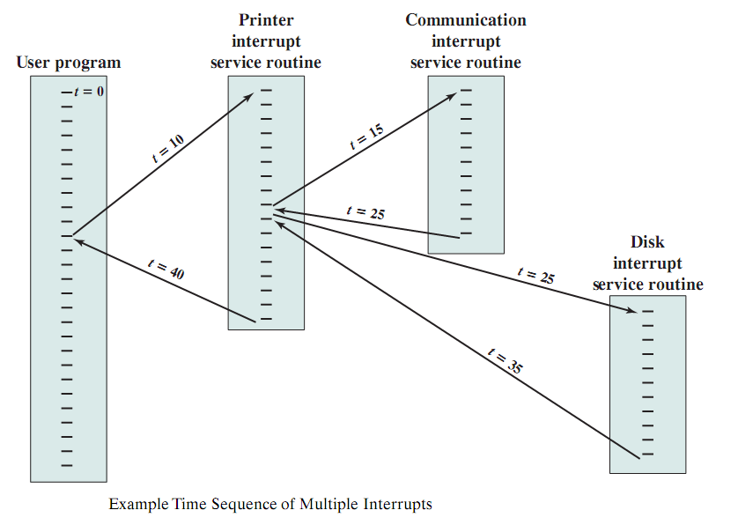
Time Sequence of Multiple Interrupts
t=0 | User Program Starts
t=10 | Printer interrupt
t =15 | Communication interrupt
t=20 | Disk interrupt

Slide 31
Thanks ALL !!!

